Slide 1
2022 Account-Based Marketing Plan for [Company Name]
Your Name Title

Slide 2
Hello! Welcome to your ABM planning template...a few tips before you get started:
There are lots of yellow bars at the top — to help you! — delete them once you’ve updated the slides with your own content.
Need to update any icons or add different template slides? Skip to our appendix where we’ve got you covered.
Have fun! (Who says planning isn’t fun?!)

Slide 3
How to use this slide: Introduce the agenda (and yourself!)
Agenda:
Why ABM for [Company Name]?
Identifying our target accounts
Engaging across channels
Measuring our results
Account-based platforms
PRESENTER
Presenter image
Presenter Name Title

Slide 4
Why ABM?

Slide 5
ABM supports our 2022 business objectives / OKRs
How to use this slide: Add your company’s high-level objectives here, to frame up the “why ABM” conversation. For example, are you trying to move up-market? Expand into new verticals? Generate more SaaS revenue? Connecting your ABM goals to overall business objectives will help you get buy-in for these initiatives
Objective 1
Objective 2
Objective 3
Objective 4
Objective 1 description
Objective 2 description
Objective 3 description
Objective 4 description

Slide 6
ABM drives revenue
Align marketing & sales
Invest more efficiently
Close deals faster
How to use this slide: If you’re still internally selling how ABM fits into your company’s overall business goals, use this slide to show the value of ABM.
Better yet, customize this slide to map to the business objectives in the previous slide.
ABM helps ensure marketing is focused on the same set of target accounts as the sales team
Running coordinated campaigns across sales and marketing improves performance
36% of growth can be attributed to revenue alignment*
ABM allows marketers to target a data-driven, prioritized set of accounts against which to prioritize our budget
Provide marketing “air cover” to the accounts that sales is already targeting
91% percent agreed ABM accounts have higher ROI rate*
The most important factor to consider? ABM contributes to the bottom-line goals of the business
Moving away from volume metrics alone toward business-critical metrics like revenue gives marketing ownership over key results
80% report wine rate was higher with ABM accounts*
*source: SiriusDecisions

Slide 7
How demand gen & account-based
work together
How to use this slide: Use this slide to show the relationship between traditional demand generation and account-based marketing.
You may want to add detail about what percentage of your mix will be attached to lead-gen or account-based goals.
Focus on accounts
More reliance on outbound
Mktg + sales in unison
Account-based
Demand gen
“”
40% of marketers said that they have integrated their demand gen and ABM processes.
- Demand Gen Report ABM Benchmark Survey
Focus on individuals
More reliance on inbound
Mktg hands leads to sales

Slide 8
Building an account-based program
Identify the right accounts
Engage across channels
Measure results
How to use this slide: Set the stage for your full ABM framework, from building your target account list to measuring the results of your programs.
Use our data and vendor data to identify our target audience, accounts, and buying committees.
Prioritize key accounts based on fit, intent, and engagement signals
Ensure the right mix of digital ads, email, sales outreach, and direct mail / gifting
Run coordinated campaigns with marketing “air cover” for sales outreach
Customize web experiences for visitors from target accounts and use custom email signature CTAs
Not abandoning metrics like new contacts or MQLs. Lead volume and quality is still important.
Will also track leads *from our TAL* as a subset of total leads generated
Look at account progression for TAL, and opportunities influenced by account-based programs

Slide 9
Identifying our audience

Slide 10
Our ABM audience foundation
How to use this slide: Define the terms you’ll use to segment your audience(s). Be clear about what you mean when you say ICP or TAL, so everyone is on the same page.
Ideal Customer Profile (ICP)
Target Account List (TAL)
Prioritized Account List
Buying Committees
The ICP represents firmographic and technographic attributes of your highest-quality customer accounts.
Target accounts should have the highest probability of closing based on shared ICP attributes.
Prioritize accounts based on fit, intent and engagement signals, our ABM goals and our sales capacity.
Identify the decision makers, influencers, and end users in each of our target accounts.

Slide 11
Our Ideal Customer Profile (ICP)
How to use this slide: Define your ICP by the relevant attributes (we’ve added some that a lot of B2B companies use, but you should make this your own)
ICP
Company Size
Industry vertical(s)
Revenue
Geography
Technographics

Slide 12
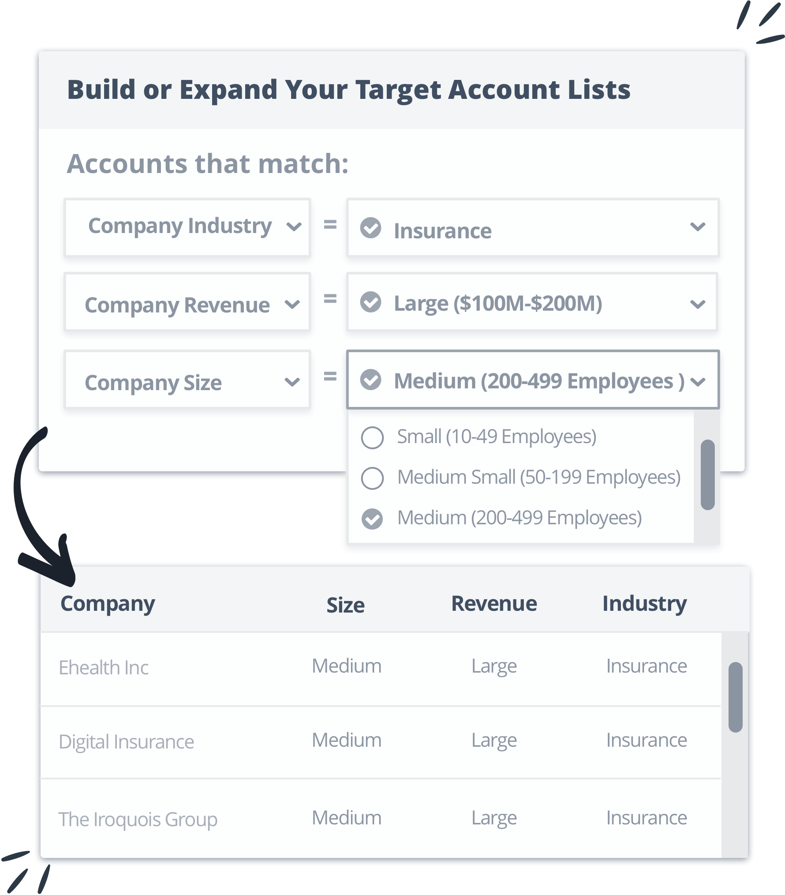
Building our Target Account List (TAL)
How to use this slide: If you don’t already have a TAL, use this slide to explain how you’ll prioritize target accounts.
How we’ll develop our TAL:
Start with our ICP to identify existing accounts in our database that match these attributes
Use vendor data to pull full set of available unknown accounts into list based on fit data and intent signals
Collaborate with sales to evaluate the quality of accounts and preliminary tiering
Use machine learning and predictive models to score/tier our account list

Slide 13
Our Target Account List (TAL)
How to use this slide: If you do already have a TAL, this slide can be used to explain who is on it and how you developed it.
If you’ve tiered your TAL, show how many accounts fall into each tier.
500 accounts
How we developed our TAL:
Started with our ICP to identify existing accounts in our database that match attributes
Used vendor data to pull full set of available unknown accounts into list based on fit data and intent signals
Collaborated with sales to evaluate the quality of accounts and preliminary tiering
Used machine learning and predictive models to score/tier our account list
Tier 1
Tier 2
1,000 accounts
Tier 3
5,000 accounts

Slide 14
Identifying buying committees
How to use this slide: Chart out your steps for finding the buying committee within your accounts, filling in the titles in the diagram if you have them.
How we’ll identify buying committees:
Start with account-to-contact matching in our own database
Use vendor databases to find buyers with certain job titles, functional areas, geographies, etc.
Begin building a map of the buying committee for each account
Build on that map by identifying buyers who are searching for solutions like ours, buyers engaging with our brand or our competitor’s brands, etc.
CTO
title
title
title
title
title
title
title

Slide 15
Engaging across channels

Slide 16
ABM engagement channels for 2022
How to use this slide: Show all the channels (and any supporting vendors) you’ll be using for your account-based programs this year.
Mail & Gifting
Digital ads
Email
Chat
Web personalization
Webinars
Sales outreach syndication
Content syndication

Slide 17
ABM strategy by stage
How to use this slide: Map your budget allocation (optional), programs, and goals/KPIs by funnel stage.
X% budget:
TOFU programs:
KPIs:
Awareness
x% budget:
MOFU programs:
KPIs:
Consideration
x% budget:
BOFU programs:
KPIs:
Purchase
x% budget:
Post-sale programs:
KPIs:
Retention/ Expansion

Slide 18
ABM program plans
How to use this slide: Break down each of the key ABM programs or initiatives you’re planning for 2022 (or maybe just H1 for now, if you’re like us!)
You can go into more detail for each program on the next slides.
Awareness
Program 1
Program 2
Nurture
Program 1
Program 2
Air cover
Program 1
Program 2
Retention
Program 1
Program 2
Pipeline acceleration
Program 1
Program 2
Expansion
Program 1
Program 2

Slide 19
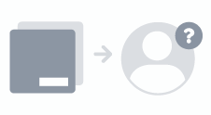
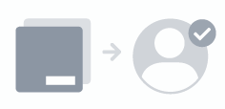
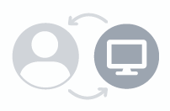
Example awareness program
How to use this slide: This is an example of how to outline a multi-touch ABM program focused on awareness. Your programs will have their own unique goals and tactics.
Use a slide like this for each account-based program you’re planning.
PLAY - Run air cover and nurture our target account before and during sales outreach.
 |  | Tactics
Account Targeting (Pre-Targeting) | Layer Account Intent | Contact Targeting | Retargeting | Sales Outreach
Serve ads to the unknown contacts & relevant personas at our target accounts | Serve ads to our target accounts demonstrating intent signals | Serve ads to the known contacts that we’ve identified | Increase account engagement with website visitors | Amplify awareness with personalized sales touches to engaged accounts
Account Based Goal
Drive known and unknown accounts through the funnel and influence opportunity creation
Account Audience
Best-fit and intent-demonstrating accounts on our prioritized target account list
Outcome
By running account-based awareness plays, we’ll encourage engagement from target accounts. Increased account and site engagement increases the likelihood of our sales team booking a meeting or closing a deal. Arming sales with information on the content consumed and the level of account engagement will help with outreach prioritization and customization.
Contact Audience
Known — Contacts on the buying committee
Unknown — New contacts at target accounts that match our persona
Measurement
Account engagement funnel progression, key account and user engagement metrics, open opportunities creation, and contract value.

Slide 20
Measuring results

Slide 21
How measuring ABM is different
Volume → Value
Accounts v. People
Revenue impact
How to use this slide: Explain how ABM metrics differ from traditional demand gen metrics, and why you’ll focus on certain measures more than others.
Adding ABM to our mix comes with a few mindset shifts. The goal is to work toward a more finite audience that is already somewhat ‘qualified’. So instead of just focusing on getting more leads, ABM is focused on getting more of the right leads (from the right accounts).
Traditionally, marketing has focused on leads—that is, individual people showing engagement. While it will always matter to have the right buyers taking action, ABM focuses on the account before the person, not the other way around.
Ultimately, just like any other marketing strategy, ABM should drive revenue. We’ll measure direct pipeline generation from ABM programs as well as revenue influence.

Slide 22
Progressing accounts through stages
How to use this slide: Use this slide to describe how you’ll measure account progression through the funnel.
You can add the current state of your TAL here, as well as any goals you may already have set.
Unaware
eg. Haven’t visited the website
Current # of unaware accounts:
2022 Goal:
Aware
eg. Visited website in last 90 days
Current # of aware accounts:
2022 Goal:
Engaged
eg. Visited 3x in the last 30 days
Current # of engaged accounts:
2022Goal:

Slide 23
How to use this slide: Outline the engagement metrics you’ll track for your target accounts. These are some sample metrics - input your own, as well as goals or targets you may have.
How to use this slide: This can be used to preface why you’ll shift some key metrics, showing the value of ABM as it impacts your dashboards.
ENGAGEMENT METRICS
Metric | Definition | Goal (#)
Accounts Reached | The number of accounts from our target account list that were served at least one ad or opened at least one email.
Accounts Visited | The number of accounts from our target account list that viewed at least one page on our site.
Accounts Engaged | The number of accounts from our target account list with at least three page views.
Unique Visitors | The number of unique visitors from all accounts reached.
Total Page Views | The number of page views from all accounts reached.
“Future Interest” Account | The number of contacts in our TAL who say the timing isn't right but reach out in the future.

Slide 24
How to use this slide: Show the metrics you’ll track for each ABM campaign or program. These are some sample metrics - input your own, as well as goals or targets you may have.
CAMPAIGN METRICS
Metric | Description | Goal (#)
Accounts Targeted | The number of accounts on our target list for the campaign.
TAL Responses Generated | The number of targeted contacts that responded to the offers (as measured by a form fill, page view, or email response.)
TAL Meetings Booked | The number of meetings booked with a seller in response to the campaign.
LT TAL Opportunities Generated | The number of net new opportunities created in response to the campaign.
LT TAL Pipeline Value $ | The dollar value of the net new opportunities generated as defined above.

Slide 25
Account-Based Platforms

Slide 26
How to use this slide: If you’re considering an account-based platform to run these programs in 2022, use this slide to compare vendors.
Oh and we gave you a little head start (you knew we would!)
ACCOUNT-BASED PLATFORM FEATURES
 |  | Vendor 2 | Vendor 3 | Vendor 4
Proprietary B2B database of accounts and buyers | ✔ | ✔
Multi-channel engagement capabilities | ✔ |  |  | ✔
Advertising reach | ✔ | ✔
Machine learning / predictive models | ✔ |  | ✔ | ✔
Intent targeting | ✔
Integrations with MAP, CRM, and other engagement channels | ✔ | ✔ |  | ✔
Full-funnel measurement | ✔

Slide 27
Thank
you!
Next steps
Step 1
Step 2
Step 3
Step 4

Slide 28
Appendix:
Icons & bonus templates

Slide 29
Icon library

Slide 30
ABM Program summary template
Program summary - Fill in
 |  | Tactics
Tactic 1 | Tactic 2 | Tactic 3 | Tactic 4 | Tactic 5
Serve ads to the unknown contacts & relevant personas at your target accounts | Serve ads to your target accounts demonstrating intent signals | Serve ads to the known contacts that you and your sales team have identified | Increase account engagement with website visitors | Amplify awareness with personalized sales touches to engaged accounts
Account Based Goal
Fill in
Account Audience
Fill in
Outcome
Fill in
Contact Audience
Fill in
Measurement
Fill in

Slide 31
Overview slide template
Adjust and replace icons as needed. If subtitle is not needed, delete this box.
Text here
Text here
Text here
Text here
Place short copy here—1 sentence max is suggested.
Place short copy here—1 sentence max is suggested.
Place short copy here—1 sentence max is suggested.
Place short copy here—1 sentence max is suggested.
Text here
Text here
Text here
Text here
Place short copy here—1 sentence max is suggested.
Place short copy here—1 sentence max is suggested.
Place short copy here—1 sentence max is suggested.
Place short copy here—1 sentence max is suggested.

Slide 32
Flow chart slide template
00
00
00
Text here
Text here
Text here
Place short copy here—1 sentence max is suggested.
Place short copy here—1 sentence max is suggested.
Place short copy here—1 sentence max is suggested.

Slide 33
“Pull quote.”
Name, title, Company
- First name Last name, Title, Company

Slide 34
Call-out.

Slide 35
Slide with chart (1/4)
Text here
Replace/delete this. If you plan on highlighting 3-4 topics, 1-2 sentences (per topic) is recommend.
Text
Place your copy here.

Slide 36
Slide with chart (2/4)
Text here
Replace/delete this. If you plan on highlighting 3-4 topics, 1-2 sentences (per topic) is recommend.
Text here
Replace/delete this. The recommended 1-2 sentences above ensures your information isn’t overwhelming or cluttered.
Text
Place your copy here.

Slide 37
Slide with chart (3/4)
Text here
Replace/delete this. If you plan on highlighting 3-4 topics, 1-2 sentences (per topic) is recommend.
Text here
Replace/delete this. The recommended 1-2 sentences above ensures your information isn’t overwhelming or cluttered.
Text here
Replace/delete this. If you plan on highlighting 3-4 topics, 1-2 sentences (per topic) is recommend.
Text
Place your copy here.

Slide 38
Slide with chart (4/4)
Text here
Replace/delete this. If you plan on highlighting 3-4 topics, 1-2 sentences (per topic) is recommend.
Text here
Replace/delete this. The recommended 1-2 sentences above ensures your information isn’t overwhelming or cluttered.
Text
Place your copy here.
Text here
Replace/delete this. If you plan on highlighting 3-4 topics, 1-2 sentences (per topic) is recommend.
Text here
Replace/delete this. The recommended 1-2 sentences above ensures your information isn’t overwhelming or cluttered.

